Slide 1
Intro to Ensembles and XGBoost
Brendan Kolisnik

Slide 2
Agenda
Decision Tree Recap
Bias / Variance Decomposition
Bagging
Random Forest
XGBoost
Boosting
Taylor Polynomial Approximation of Loss Function
Fitting Procedure: Tree Method, Growth Policy
Regularization

Slide 3
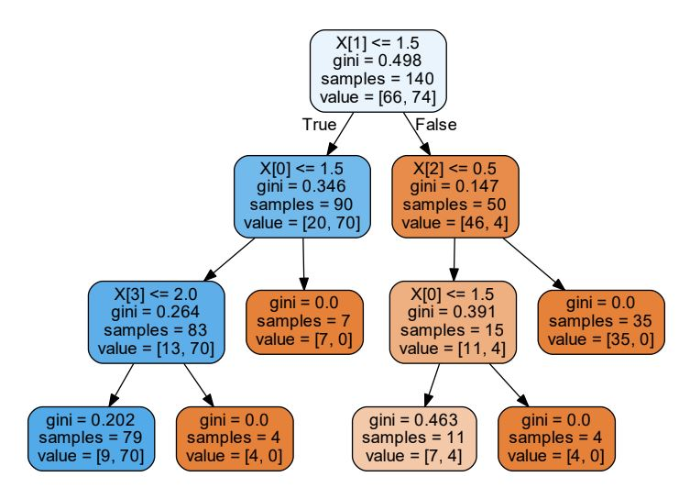
Decision Tree Visualization

Slide 4
Decision Tree Overview
Recursively partition feature space so that samples with similar labels are grouped together.
At each internal node in the tree need to choose a split. Split is a feature and threshold pair. Choose the split that minimizes a loss function or impurity function. For classification we may use entropy, for regression we may use MSE.
Repeat until a certain depth is reached, there are too few samples per leaf, or other regularization constraints are no longer satisfied.

Slide 5
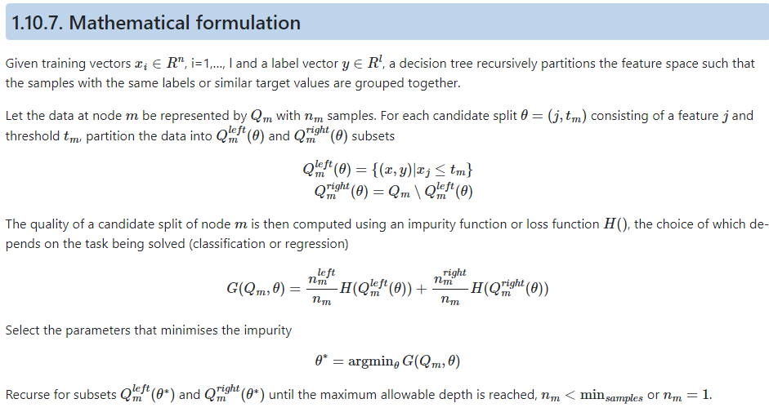
Decision Tree Scikit-Learn Mathematics
Simple interpretable model
Add your second bullet point here
Add your third bullet point here

Slide 6
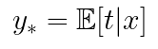
Bias and Variance Setup
Let’s assume that for our training set D consists of training pairs (xi,ti) that are sampled I.I.D from a data generating distribution p(xi,ti). Notice this is a joint distribution. Let’s also assume we are using squared error as our loss function.
For a test query point let’s assume we knew p(t|x).
Given can we decompose our loss function?
Our prediction for a query test point will be a random variable y and notice that y is independent of the test label random variable t since the model has never seen this t before.

Slide 7
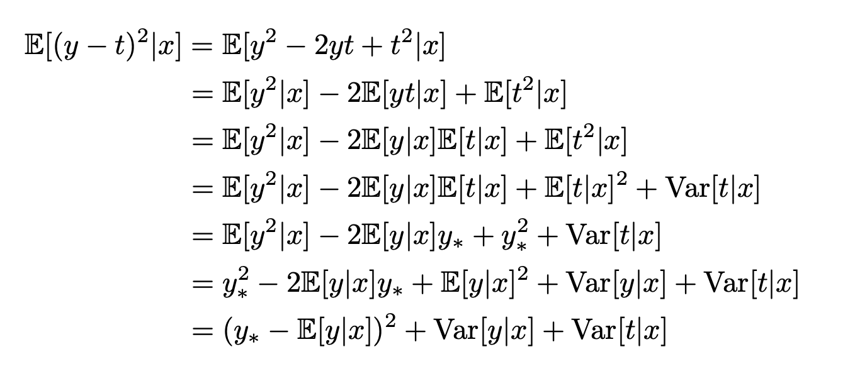
Bias and Variance Decomposition
We can represent the loss as the sum of three error terms.
Bayes Error is the irreducible noise in the dataset.
Bias
Variance
Bayes Error
Notes:
How do we achieve 0 bias? How do we achieve 0 variance?

Slide 8
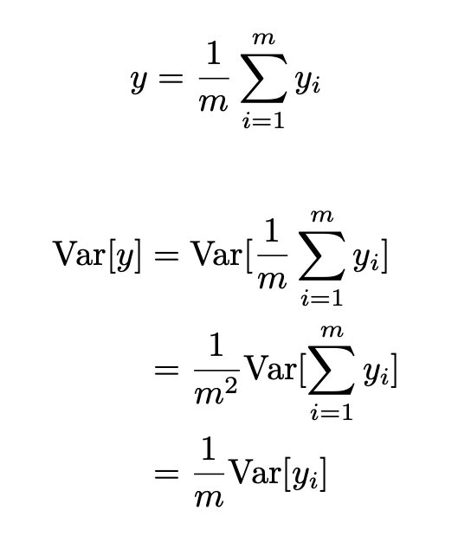
Improving Model Performance
Let’s say we had m independently sampled datasets, we trained a model on each dataset and then we averaged the predictions. We would get reduction in variance.
Bias of ensemble same as bias of individual model.
The problem is we have one dataset with n examples.
We don’t want to split it into m segments
Could increase bias of each model for small dataset.

Slide 9
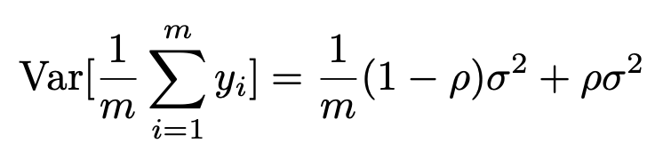
Bootstrap Aggregating (Bagging)
Instead of sampling without replacement we can sample with replacement.
If our predictions yi have variance 𝝈 and correlation 𝜌 then
If correlation is 1 then variance of the ensemble is the same as one individual tree. If the correlation is 0 then we achieve the 1/m reduction.

Slide 10
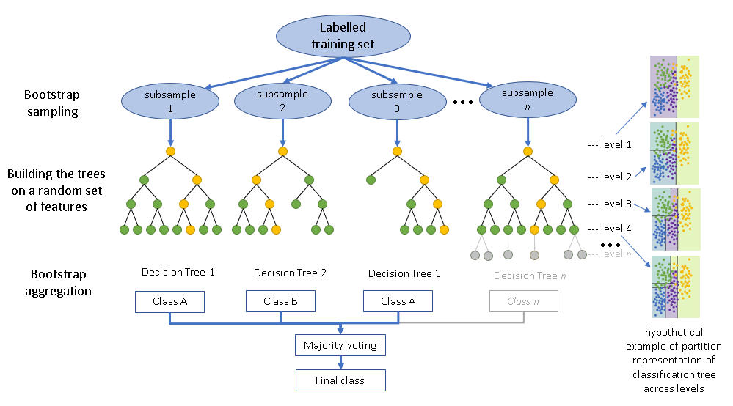
Random Forest
Random forest is bagged decision trees with one additional change. At each node in the decision tree we will only have a random subset of features to choose from. Helps reduce correlation.

Slide 11
XGBoost – Tree Ensemble Part 1
Instead of focusing on reducing variance, what if we focus mostly on reducing bias v.s. a single decision tree.
This is the approach of gradient boosted trees.
Gradient boosted trees use a slightly different decision tree known as a regression tree which makes a continuous prediction even for the classification task (weights undergo logit transform).
Given training dataset D with feature vectors xi and targets yi

Slide 12
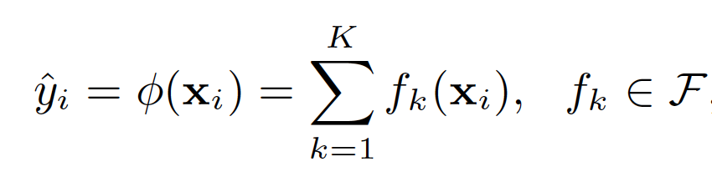
XGBoost – Tree Ensemble Part 2
A tree ensemble prediction with K trees can be represented as:
Where: fk corresponds to an independent tree structure q and leaf weights w. q is the decision tree rules. There are T leaves in a particular tree.
Notes:
Draw example on whiteboard.

Slide 13
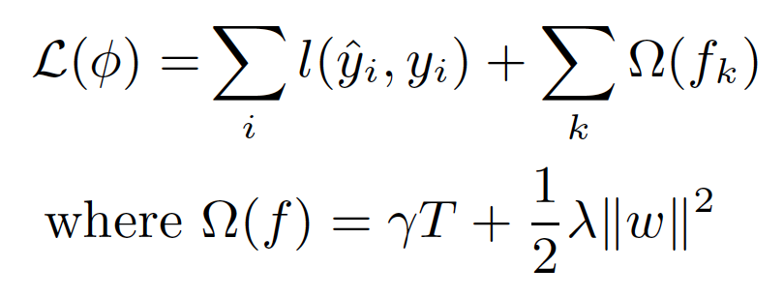
XGBoost – Gradient Tree Boosting
To learn the set of functions used in the model we minimize the following regularized objective:
Where l is the per sample differentiable and convex loss function and omega penalizes the complexity of the tree and applies L2-regularization to the weight vector.
Notes:
This is additional regularization beyond traditional GBM

Slide 14
XGBoost – Gradient Tree Boosting
To learn the set of functions used in the model we minimize the following regularized objective:
Where l is the per sample differentiable and convex loss function and omega penalizes the complexity of the tree and applies L2-regularization to the weight vector.
Draw!
Notes:
This is additional regularization beyond traditional GBM

Slide 15
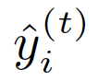
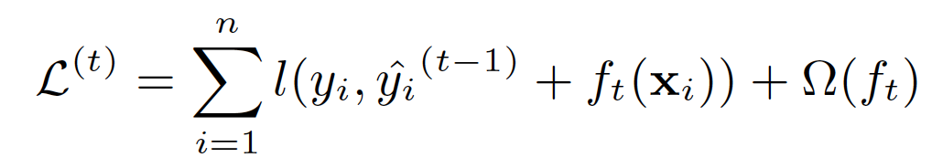

XGBoost – Gradient Tree Boosting
Model is trained in an additive manner. Let be the prediction of the i-th instance at the t-th iteration. We need to add ft to minimize the following objective:
We want to optimize this function to learn ft which is currently unknown. However, it is required to evaluate the loss? We cannot optimize this directly, but we can optimize an approximation.
Notes:
We are going to build the ensemble one tree at a time but what is the loss function that even our first tree is minimizing? Our base value will be a prediction of 0.5 Draw the idea.

Slide 16

XGBoost – Gradient Tree Boosting
Model is trained in an additive manner. Let be the prediction of the i-th instance at the t-th iteration. We need to add ft to minimize the following objective:
We want to optimize this function to learn ft which is currently unknown. However, it is required to evaluate the loss? We cannot optimize this directly, but we can optimize an approximation.
Draw!
Notes:
We are going to build the ensemble one tree at a time but what is the loss function that even our first tree is minimizing? Our base value will be a prediction of 0.5 Draw the idea.

Slide 17
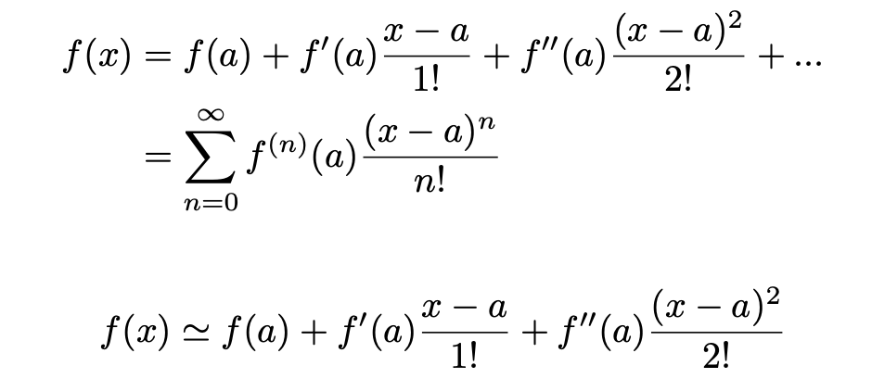
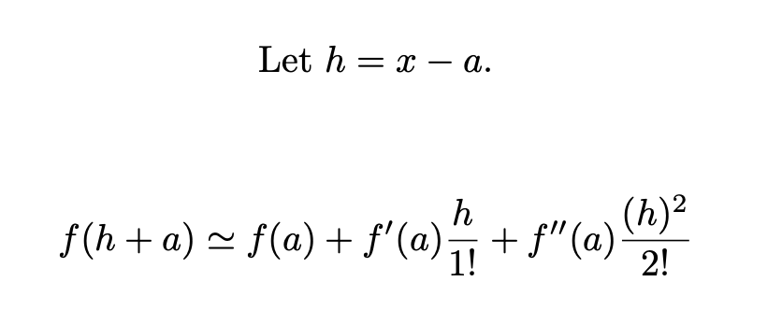
XGBoost – Second Order Taylor Polynomial
Notes:
Write the approximation as a constant plus a variable.

Slide 18
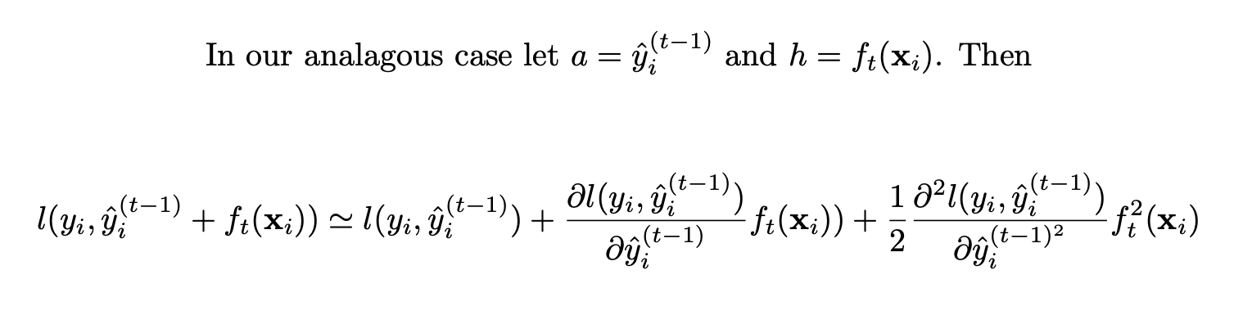
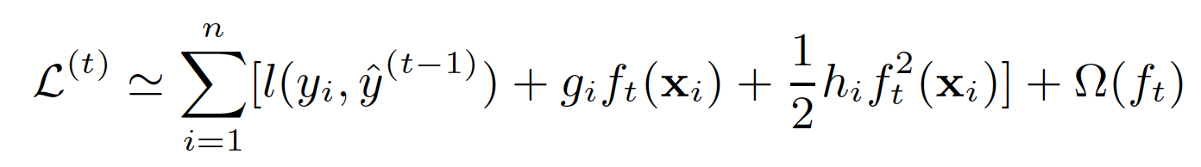
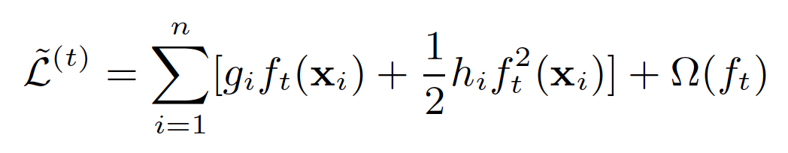


XGBoost – Second Order Taylor Polynomial
Notes:
Is this objective also convex in terms of ft? Yes. That means that any minimum is also the GLOBAL minimum.

Slide 19
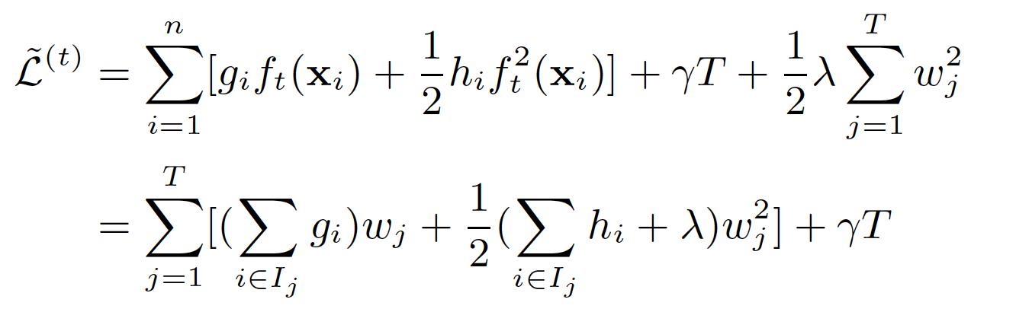
XGBoost – Rewriting Loss in Terms of Leaves
Notes:
Is it convex in terms of wj? Why does that matter?

Slide 20
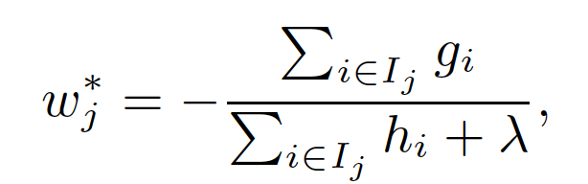
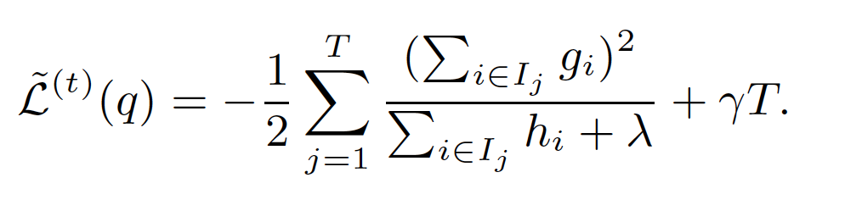
XGBoost – Final Loss
For a fixed q(x) we can take the gradient w.r.t w, set equal to 0 and solve.
Final Loss with optimal weight substituted in:

Slide 21
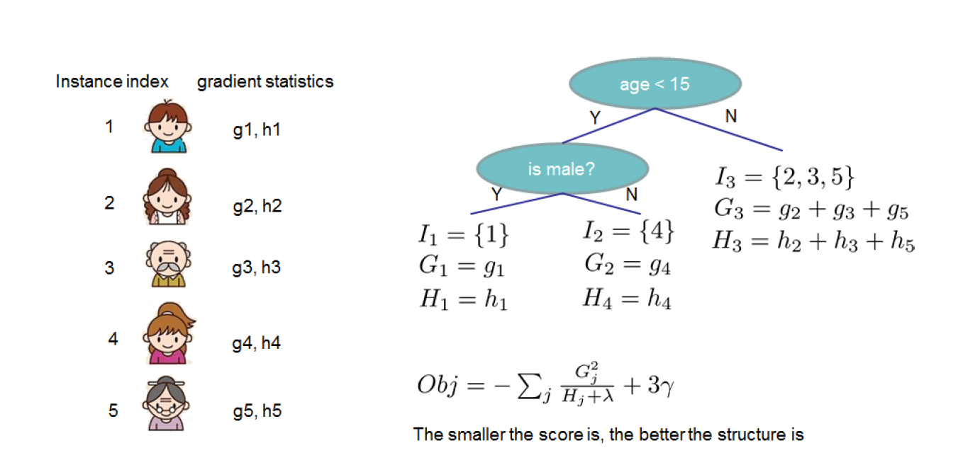
XGBoost – Score a Tree

Slide 22
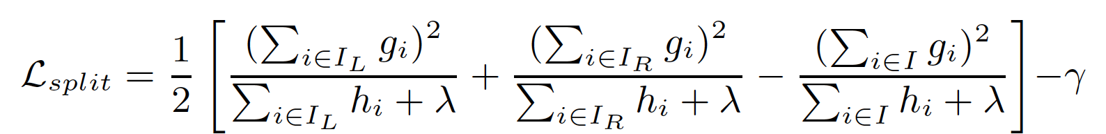
XGBoost – How to evaluate split candidates?
In essence: Parent Loss – (Left Loss + Right Loss)
The loss reduction is further penalized by gamma * num leaves. Adding two extra leaves must reduce loss by enough to warrant additional complexity.
Additionally, we can scale each new tree’s predictions by eta our learning rate. We can also apply lessons from random forest and randomly sample features for consideration.

Slide 23
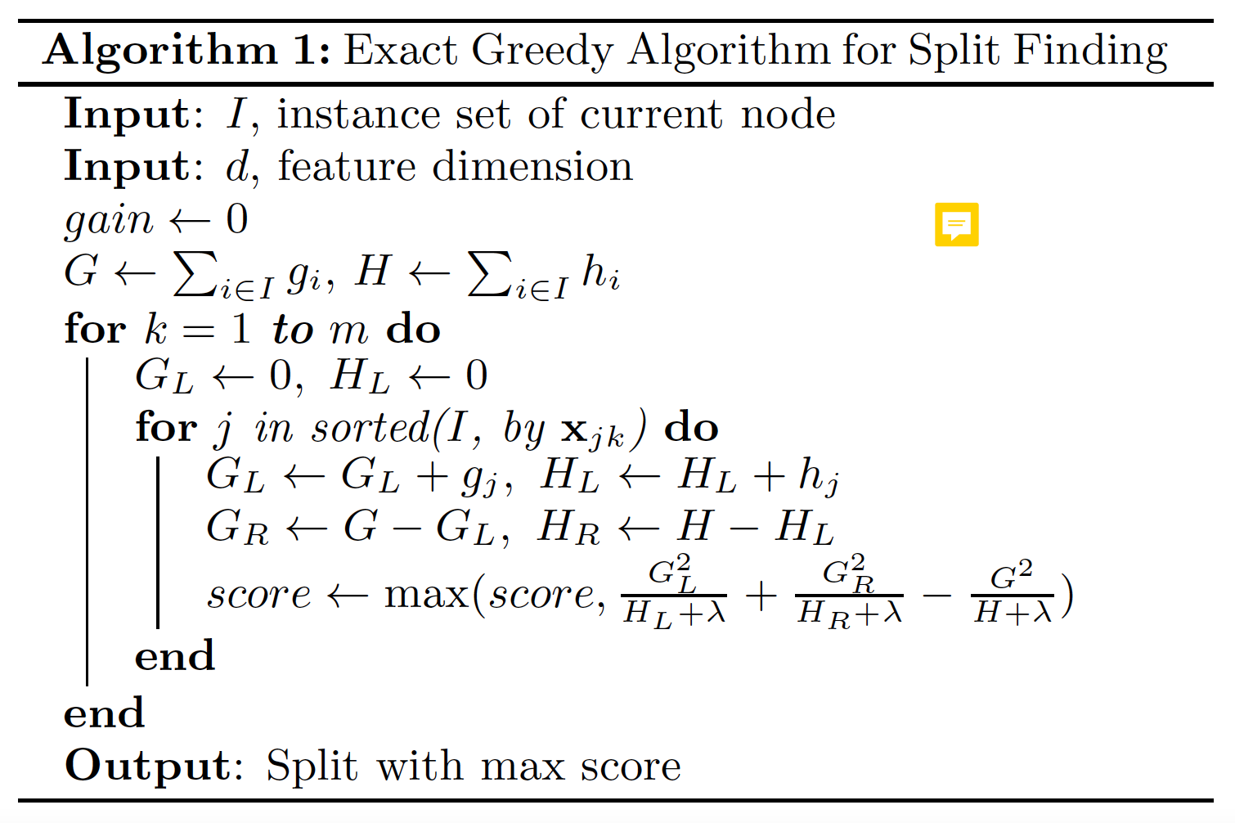
XGBoost – How to find split candidates?

Slide 24
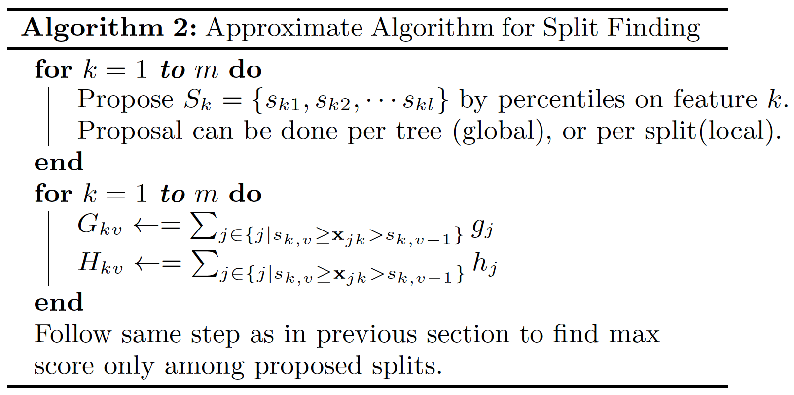
XGBoost – How to find split candidates?

Slide 25
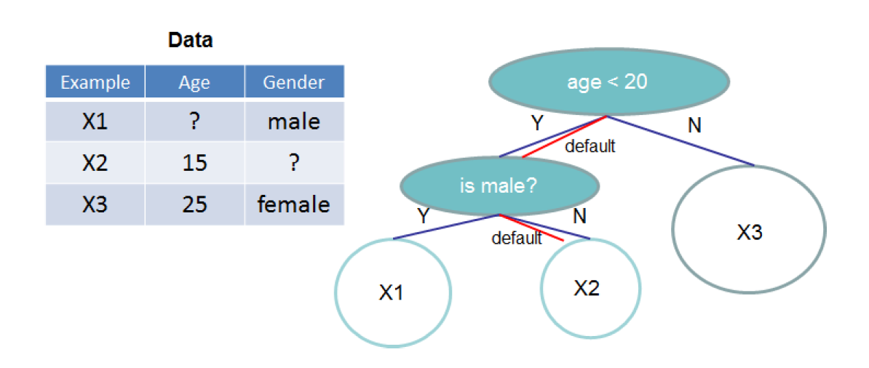
XGBoost – Missing Data?
Learn default directions for each internal node in the tree by whichever direction minimizes training loss more.

Slide 26
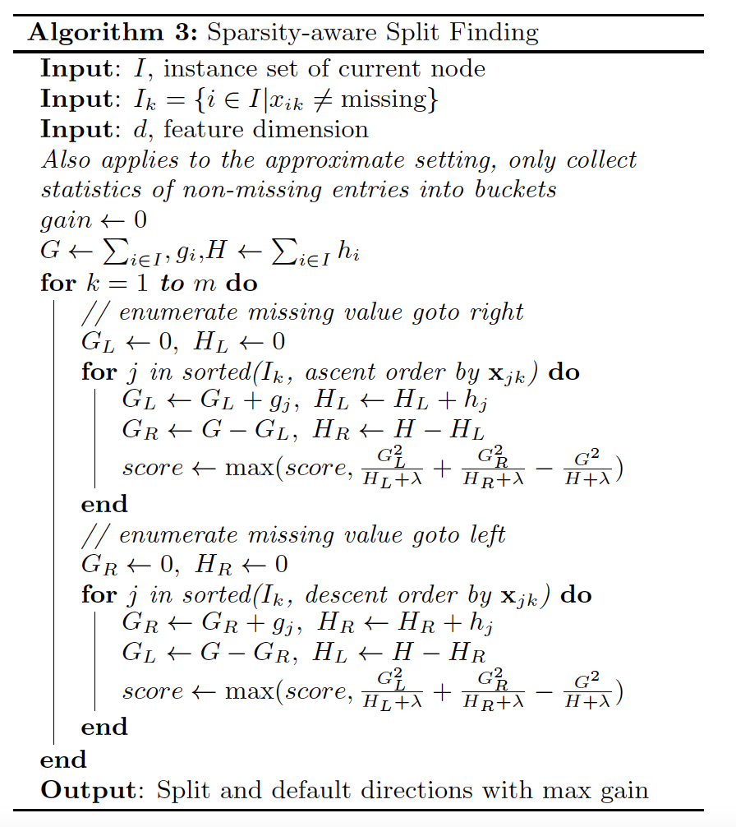
XGBoost – Missing Data?
Try missing values in left and right subset and compare loss reduction.

Slide 27
XGBoost – Regularization
Two major options for growth policy:
Depthwise: Default and grows tree one level at a time.
Lossguide: Favors splitting at nodes with greatest reduction in loss.
Beyond feature sampling (col sampling) we can also perform bagging per tree (known as subsample).
Max depth, max leaves, min children.
L1 or L2 regularization on weights.

Slide 28

Questions

